Slide 1


SMART INDIA HACKATHON 2024
Problem Statement ID – 1654
Problem Statement Title- Determining expert relevance with respect to interview board subject and candidates’ area of expertise.
Theme- Smart Automation
PS Category- Software
Team ID - 99
Team Name- DYNAMO

Slide 2
IDEA
DYNAMO
KEY POINTS
PROBLEM ADDRESSED
INNOVATION & UNIQUENESS
Profile Collection
Data Analysis
Matching Process
Panel Creation
Web Application
Efficiency
Accuracy
Bias Reduction
Resource Optimization
Consistent
Advanced NLP
Comprehensive Scoring
Automated Suggestions
Modern Tech
Scalability & Adaptability

Slide 3
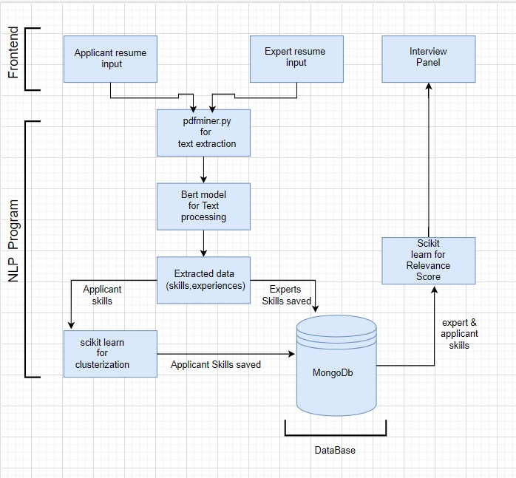
TECHNICAL APPROACH
DYNAMO
Frontend
Backend
Flask/Django
Hugging face
Text process
Feature Extraction
Similarity Scoring &Calculation
React.js
HTML/CSS
MongoDB
Database
Development
Cloud Services

Slide 4
FEASIBILITY AND VIABILITY
DYNAMO
Technical Feasibility
Economic Feasibility
Legal Feasibility
Scalability
Resource availability
FEASIBILITY ANALYSIS
VIABILITY
Organizational Impact
Long-Term Sustainability
Regulatory and Ethical Considerations
Adoption and Integration

Slide 5
IMPACT AND BENEFITS
DYNAMO
POTENTIAL IMPACT ON THE TARGET AUDIENCE
BENEFITS OF THE SOLUTION
SOCIAL:
Reduces Bias
Improves Interview Quality
ECONOMIC:
Saves Time and Resources
Reduces Costs
ENVIROMNETAL:
Reduces Paperwork
Supports Sustainability
Enhance Recruitment
Improved Candidate Experience
Efficient Resource Utilization
Smart Scheduling

Slide 6
RESEARCH AND REFERENCES
DYNAMO
Julian, Anitha, and K. Haripriya. "NLP based Resume Analysis and Adaptive Skill Assessment System." 2024 3rd International Conference for Innovation in Technology (INOCON). IEEE, 2024.
Julian, A., & Haripriya, K. (2024, March). NLP based Resume Analysis and Adaptive Skill Assessment System. In 2024 3rd International Conference for Innovation in Technology (INOCON) (pp. 1-5). IEEE.
Julian, Anitha, and K. Haripriya. "NLP based Resume Analysis and Adaptive Skill Assessment System." In 2024 3rd International Conference for Innovation in Technology (INOCON), pp. 1-5. IEEE, 2024.
Julian, A. and Haripriya, K., 2024, March. NLP based Resume Analysis and Adaptive Skill Assessment System. In 2024 3rd International Conference for Innovation in Technology (INOCON) (pp. 1-5). IEEE.
Julian A, Haripriya K. NLP based Resume Analysis and Adaptive Skill Assessment System. In2024 3rd International Conference for Innovation in Technology (INOCON) 2024 Mar 1 (pp. 1-5). IEEE.

